Slide 1
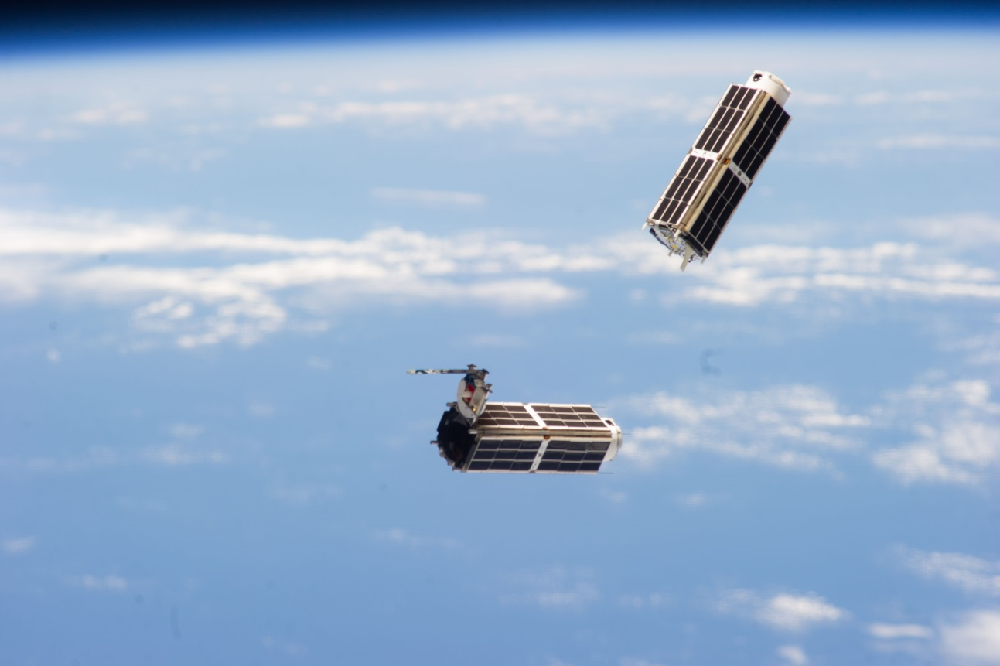
Optimizing CubeSat Attitude Control
Dmitriy Rivkin

Slide 2
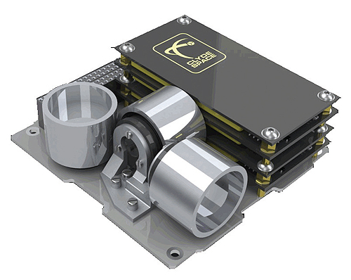
Reaction Wheel Control Scheme
Three flywheels mounted along body (x,y,z) axes
Actuated using brushless DC motors
Conservation of momentum: spin the wheels one way, the satellite spins the other way

Slide 3
Reaction Wheel Advantages
No fuel burned (energy used is electrical)
High performance

Slide 4
Optimization Objectives
1. Minimize time for large-angle slew
2. Minimize electrical energy consumed (final time fixed)

Slide 5
Dynamic Model
System is modeled as four rotating rigid bodies
3 wheels and 1 satellite body
Centers of mass fixed w.r.t. overall center of mass
Control input is acceleration of reaction wheels (motor torque/wheel MOI)
Quaternion attitude representation

Slide 6
Parameters of Optimized Problem
1u CubeSat
10cm cube , 1kg
MOI = 1.528 kg*mm
Wheel MOI = 0.101 kg*mm
100g wheels, 90mm diameter
Satellite body is 10cm cube
Uniform mass distribution
Motor torque
3mNm (Faulhaber 2610b)

Slide 7
Constraints
|Wheel acceleration| <30 rad/s²
Comes from wheel MOI and motor torque
|Wheel speed|<630 rad/s
Motor really will output full torque through the whole speed range if controlled appropriately

Slide 8
Time Optimization
Large slew angle
Cost function = t_{f}
Numerical solution obtained (N=50)
10 states
wheels speeds, body rate, orientation
3 controls
acceleration of each wheel

Slide 9
Time Optimal Results: Path

Slide 10
Controls
Clearly Bang-Bang

Slide 11
Rotation Rates

Slide 12
Hamiltonian Value Condition

Slide 13
Hamiltonian Minimization Condition
Analytical derivatives computed using Matlab

Slide 14
Discussion of Time Optimal Results
Lengthy computation
About 5 minutes for N=16 no guess
Solution is sometimes not found for higher numbers nodes
Have to “work your way up” by getting solutions for smaller numbers of nodes and using them as guesses
Not nice computationally because of discontinuous nature of solution

Slide 15
Discussion of Time Optimal Results
Significant performance improvement over linear quaternion error feedback control law
3.5s vs about 12s
Bang bang solution was expected

Slide 16
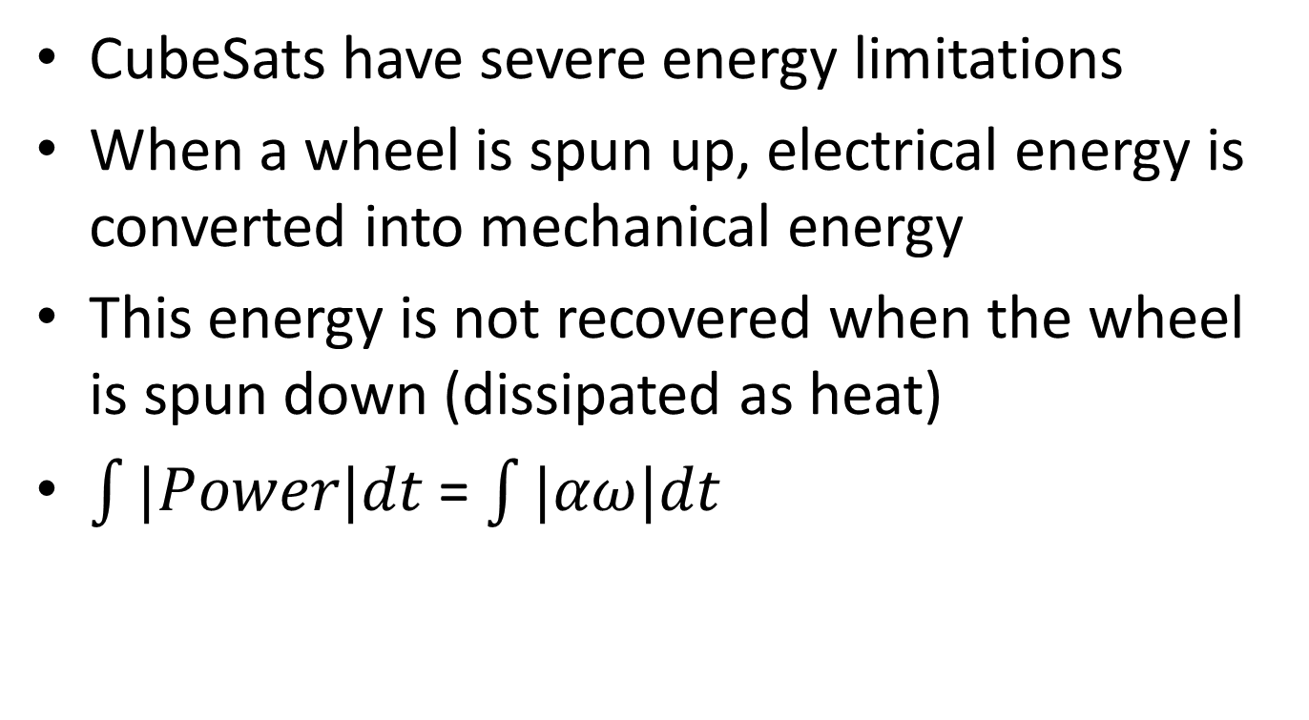
Main Source of Energy Loss
CubeSats have severe energy limitations
When a wheel is spun up, electrical energy is converted into mechanical energy
This energy is not recovered when the wheel is spun down (dissipated as heat)
$\int{|Power|dt}$ = $\int{|αω|dt}$

Slide 17
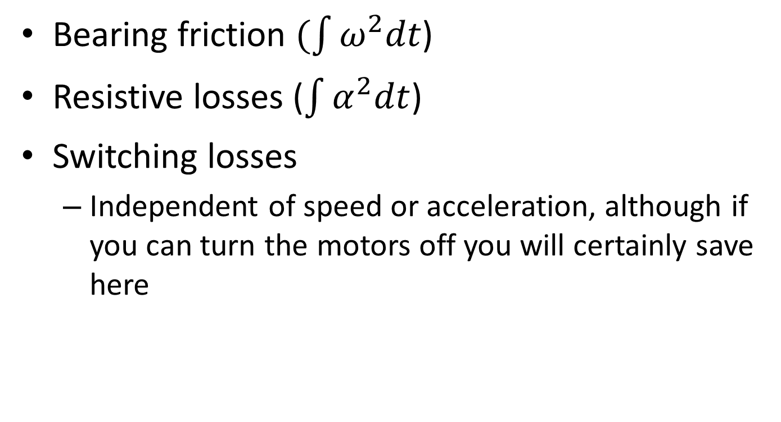
Other Losses
Bearing friction $(\int{ω^{2}dt}$)
Resistive losses ($\int{α^{2}dt}$)
Switching losses
Independent of speed or acceleration, although if you can turn the motors off you will certainly save here

Slide 18
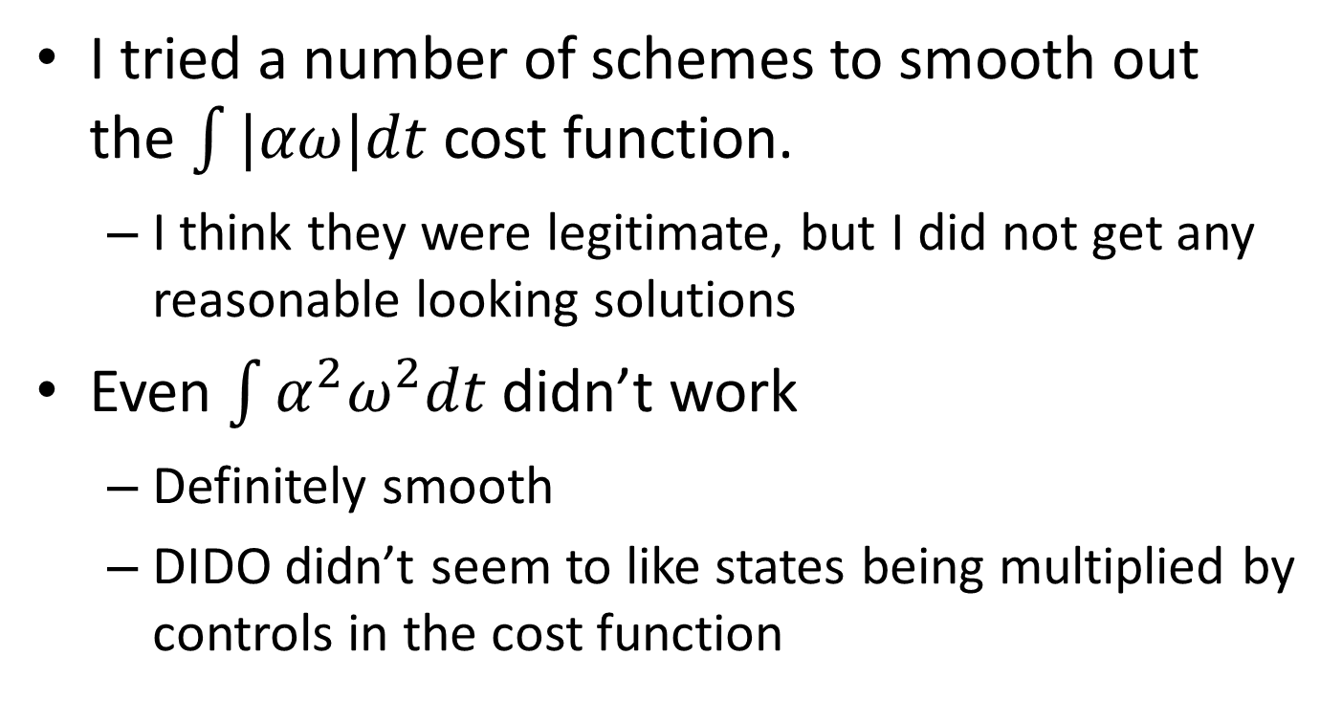
Issues with |power| Cost Function
I tried a number of schemes to smooth out the $\int{|αω|dt}$ cost function.
I think they were legitimate, but I did not get any reasonable looking solutions
Even $\int{α^{2}ω^{2}dt}$ didn’t work
Definitely smooth
DIDO didn’t seem to like states being multiplied by controls in the cost function

Slide 19
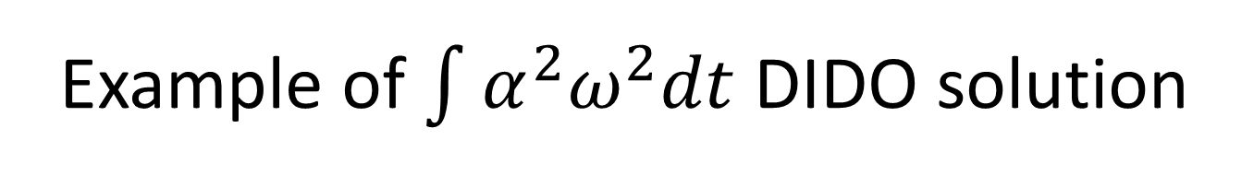
Example of $\int{α^{2}ω^{2}dt}$ DIDO solution
N = 64
It’s bad

Slide 20

What to do?
Eventually I gave up, and tried the cost function $\int{ω^{2}dt}$
Results!

Slide 21
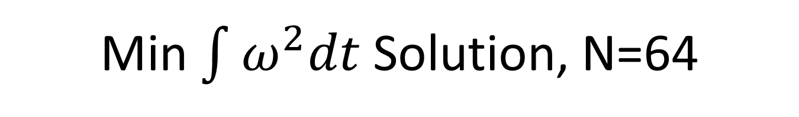
Min $\int{ω^{2}dt}$ Solution, N=64

Slide 22
Controls

Slide 23
Satellite Body Rate

Slide 24
HVC

Slide 25
HMC

Slide 26
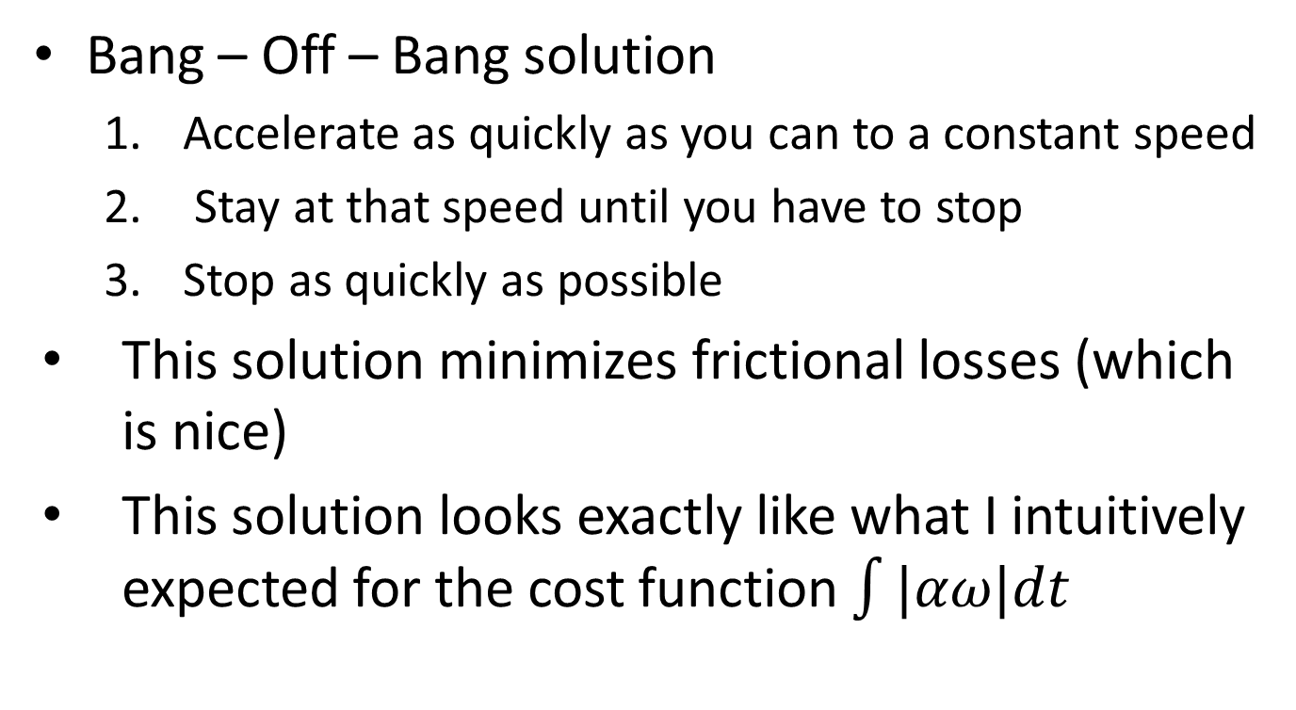
Discussion
Bang – Off – Bang solution
Accelerate as quickly as you can to a constant speed
Stay at that speed until you have to stop
Stop as quickly as possible
This solution minimizes frictional losses (which is nice)
This solution looks exactly like what I intuitively expected for the cost function $\int{|αω|dt}$

Slide 27
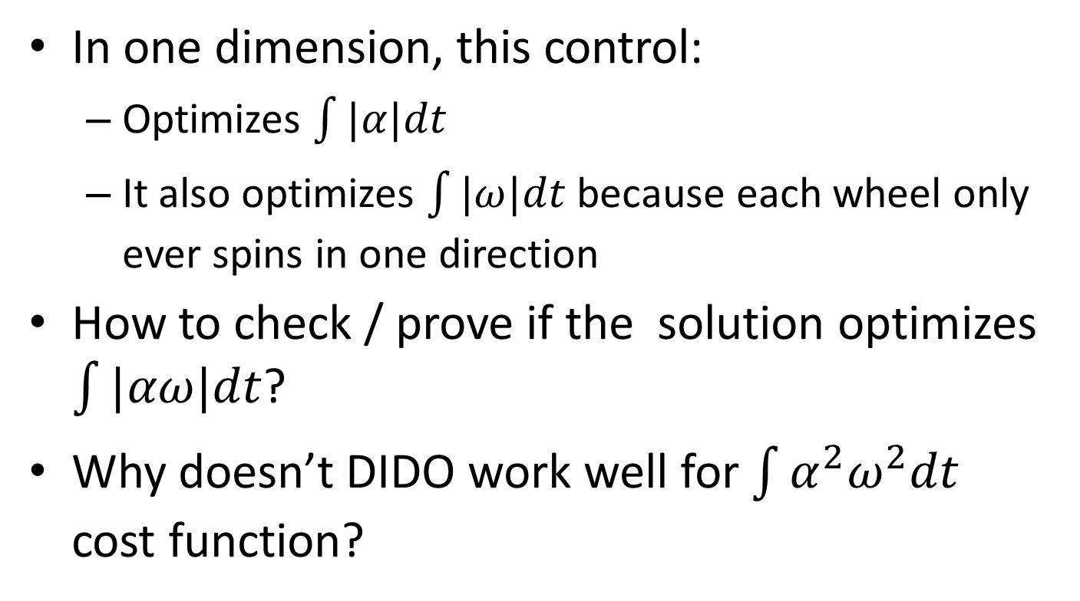
Discussion
In one dimension, this control:
Optimizes $\int{|α|dt}$
It also optimizes $\int{|ω|dt}$ because each wheel only ever spins in one direction
How to check / prove if the solution optimizes $\int{|αω|dt}$?
Why doesn’t DIDO work well for $\int{α^{2}ω^{2}dt}$ cost function?

Slide 28
To Do
Optimize 3U CubeSat trajectories (30x10x10 cm)
More likely to have this kind of controller
Suggestions?

